Slide 1
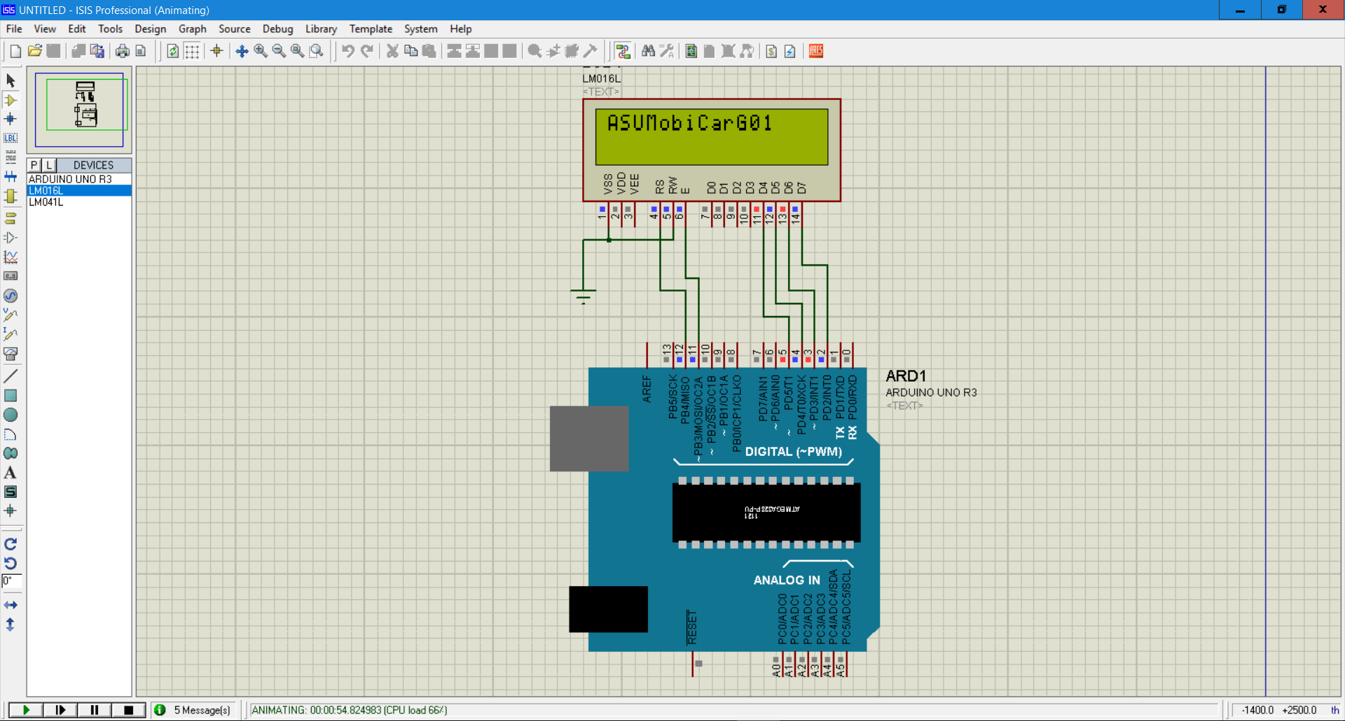
Arduino to LCD

Slide 2
#include <LiquidCrystal.h> const int rs = 12, en = 11, d4 = 5, d5 = 4, d6 = 3, d7 = 2; LiquidCrystal lcd(rs, en, d4, d5, d6, d7); void setup() { lcd.begin(16, 2); lcd.print("ASUMobiCarG01"); } void loop() { lcd.setCursor(5, 1); }

